Slide 1
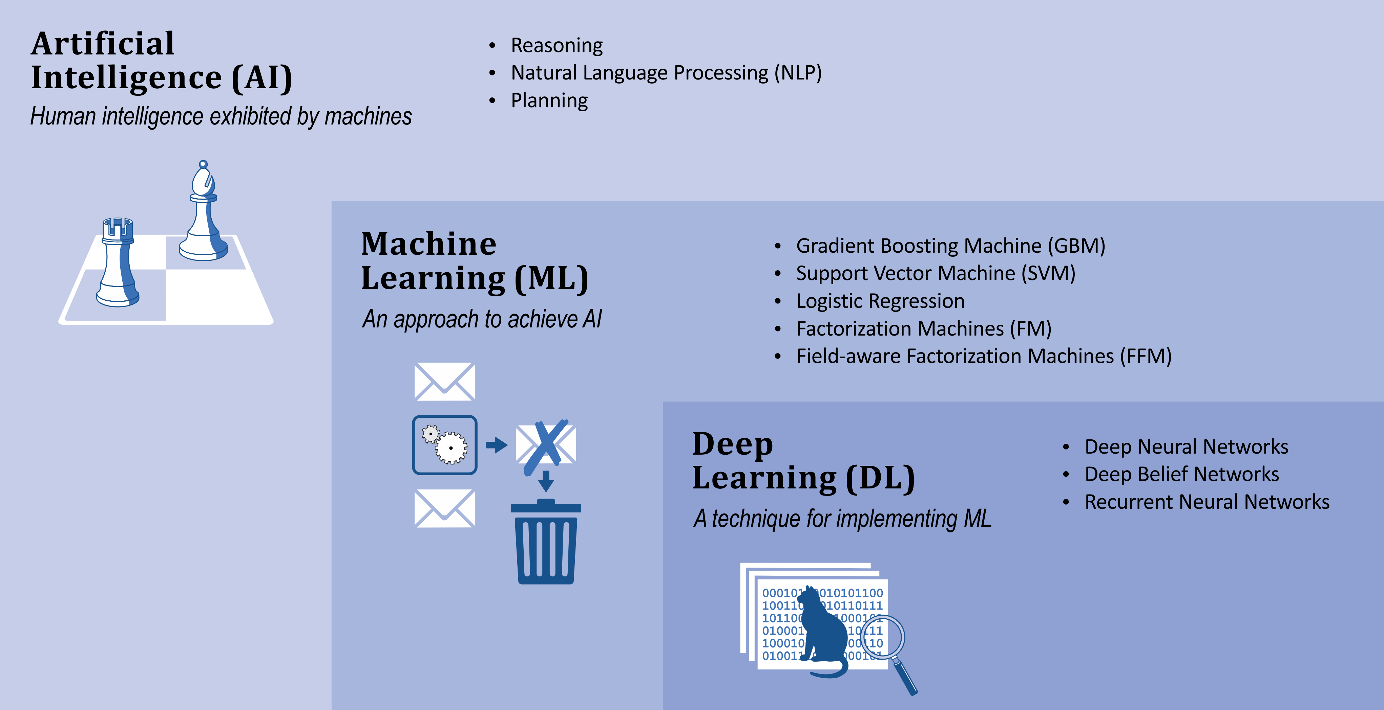
What is Machine Learning?
Notes:
Artificial Intelligence (AI) is the broadest concept of machines being able to carry out tasks that mimic human capabilities:
Once such a capability has been mastered it may no longer be called AI e.g. Deep Blue’s win against world champion chess player Garry Kasparov in 1996.
Examples of AI at the time of unveiling: IBM’s Watson win at Jeopardy in 2011
Google’s AlphaGo win against top Go players in 2016 are good examples of significant AI achievements.
Reasoning, planning, and natural language understanding are AI capabilities.
Machine Learning (ML)
an AI capability based around the idea that we should be able to give machines access to data and let them learn for themselves
a machine “learns” if it gets better at performing a specific task as it gains experience.
For instance, an email spam detector might get better at differentiating between valid emails and spam by “learning” from emails that are discarded as spam.
Deep Learning (DL)
a class of machine learning algorithms that produce models composed of deep neural networks
Compared to non-DL, or classical ML algorithms, DL achieve world-class performance in a set of important applications, including image recognition and machine translation
Take the same “secret sauce” that makes common classical ML algorithms work (defining a loss function to describe the delta between the actual outputs of a given set of inputs and the predicted output from the model; and using derivatives of that loss function to determine how to update weights in the model to minimize the loss function and thus maximize the accuracy of the prediction) and generalize it to work across multiple layers of weights
You are sitting here today because of the accomplishments of deep learning – classical ML continues to provide value in many applications and has important advantages (including requiring less data and being much more explainable), but the breakthroughs, headlines, promise and concern is because of deep learning
The starting gun of the deep learning revolution was in 2012 when a team using a deep learning approach achieved a result on Imagenet (an image recognition challenge) that was an order of magnitude better than what had been accomplished up to that point
While the math behind deep learning is decades old, the flashpoint was only 7 years ago, and it’s only in the subsequent 5 years or so that the combination of stable usable frameworks, cheap (especially cloud) hardware, and accessible learning materials has made DL of interest to non-specialists

Slide 2
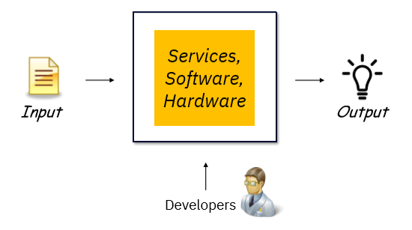
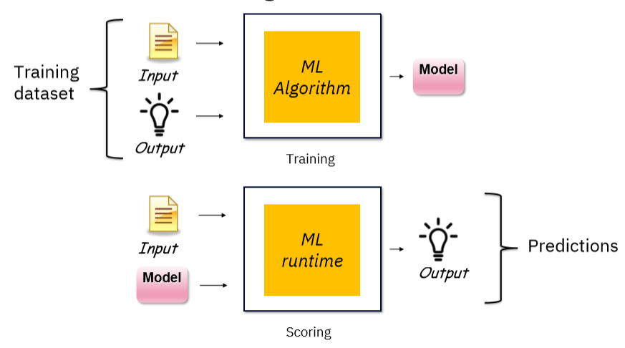
What is Machine Learning?
Classical Programming
Machine Learning
Notes:
Classical Programming:
Data is processed through code that is created by a developer to produce an output.
The behaviour of the code may depend on the input data, but the code itself is immutable (with the exception of overloading functions to have different behaviour based on the type of the argument with which it is called – but even there the developer explicitly specified the behaviour)
Machine Learning
The code organizes itself, determines its behaviour relative to input it sees when it is deployed, based on the data it has seen in the training phase.
By showing the ML algorithm the input and the actual output (for example, the number of rooms and square footage of houses, along with their selling prices), you get a trained model
Once you have a trained model, you feed it and (new) input data into the ML runtime to get predictions
You still have coding to do with machine learning – you will see some of the steps it takes to prepare data to train a model, and ML algorithms are still picky about what kind of data they can be trained with – but the lines of code where the model is trained can:
Very short
Boilerplate
There are aspects of getting value out of machine learning applications that are different than classical programming:
Tracking model accuracy – assessing whether the model continues to make accurate predictions on new data
Retraining – updating models to ensure that accuracy standards are maintained

Slide 3
Use case for ML: the customer churn problem
Customer churn: when a customer ends their relationship with a business
PROBLEM: You need to predict which of your customers are loyal and which are at risk of churning
SOLUTION: Use data you have about clients to build a model that can predict whether a given client is going to churn

Slide 4
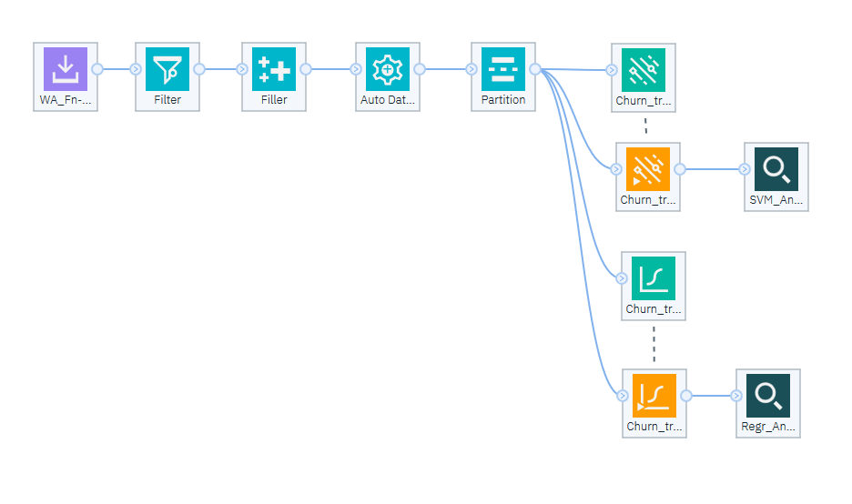
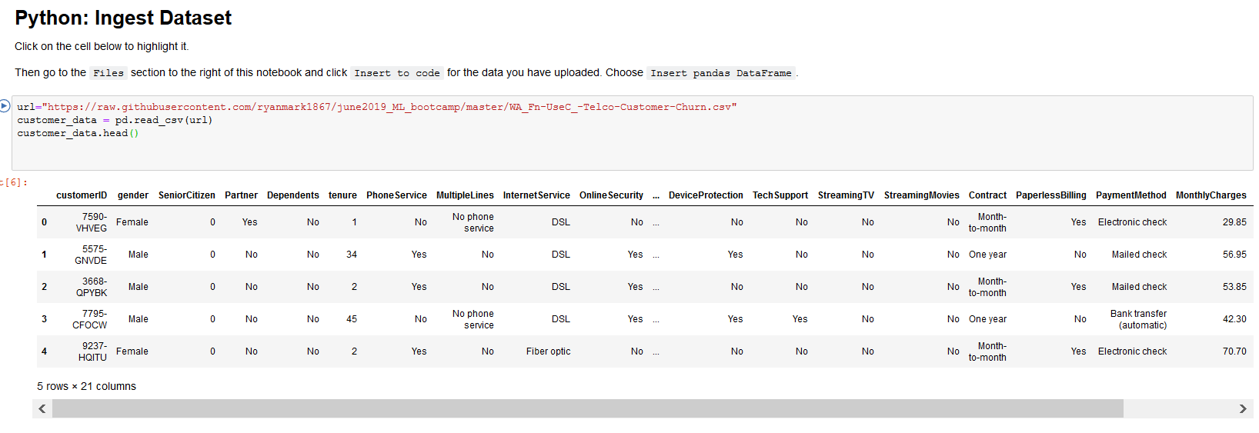
Customer Churn: the game plan
Solve the customer churn problem using Modeler, a visual data science & machine learning solution
Solve the customer churn problem using Python, the most popular language for ML

Slide 5
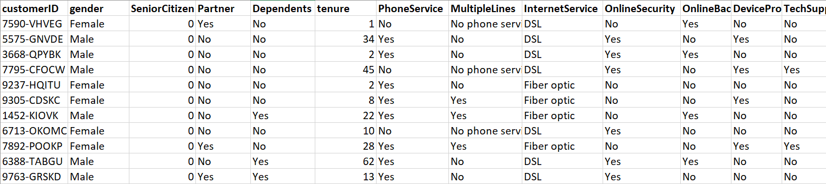
Customer churn: dataset
CSV file with ~7k records, 21 columns
Numeric columns: tenure, MonthlyCharges, TotalCharges
Categorical columns: gender, SeniorCitizen, Partner...
Target / Label: Churn

Slide 6
Customer churn: preparing the dataset for ML
Original dataset
Why?
Keep a subset of columns
Pick just the columns needed for the model
Deal with missing values
ML algorithms need numeric input
Deal with outliers
Scale continuous values
Deal with string values
Control impact of anomalies
Consistent impact of columns
ML algorithms need numeric input
Split Dataset into Train & Test
Need to reserve a portion of the data the model has never seen to validate the model

Slide 7
Customer churn: machine learning model 1
Logistic regression
Classification: churn / no churn
Extension of linear regression, simplest algorithm used to predict continuous values (e.g. house prices given number of bedrooms, square footage, etc)
“Geared” to output between 0 and 1; treat 0.5 as the boundary
Given X (customer info) and Y (actual churn/no churn), define Ŷ = aX + b
Ŷ is the prediction; X is the input; a is the weights, and b is the offset
Secret sauce:
Define a loss function (delta between predictions and actual values)
Repeatedly update weights and offset:
Get the partial derivative of the loss function with respect to the weight and offset
Update the weight and offset by their respective partial derivatives
Making updates based on “the slope” of the loss function will reduce the loss function -> increase the accuracy of the prediction
Notes:
Logistic regression models the probabilities for classification problems with two possible outcomes. It’s an extension of the linear regression model for classification problems.
Instead of fitting a straight line or hyperplane, the logistic regression model uses the logistic function to squeeze the output of a linear equation between 0 and 1. The logistic function is defined as:
logistic(η)=11+exp(−η)
https://christophm.github.io/interpretable-ml-book/logistic.html
An adaptation of linear regression
Linear regression: https://christophm.github.io/interpretable-ml-book/limo.html#limo
Implementation of linear regression:
https://towardsdatascience.com/linear-regression-using-gradient-descent-97a6c8700931
Y = Mx + c
Gradient descent is an iterative optimization algorithm to find the minimum of a function. Here that function is our Loss Function.

Slide 8
Customer churn: machine learning model 2
Support Vector Machine (SVM)
Classification: churn / no churn
Like logistic regression, also an extension of linear regression, but instead of output values between 0 and 1 outputs values greater than 1, less than -1
Goal is to maximize the distance between the class boundary (a line in 2D and a plane in 3D) and the data points
Different loss function but same secret sauce:
Repeatedly take the partial derivative of the loss function and use it to update the weights until the loss function is reduced and accuracy is optimized
Notes:
Support Vector Machine: https://towardsdatascience.com/support-vector-machine-introduction-to-machine-learning-algorithms-934a444fca47
Support Vector Machine, abbreviated as SVM can be used for both regression and classification tasks. But, it is widely used in classification objectives.
The objective of the support vector machine algorithm is to find a hyperplane in an N-dimensional space(N — the number of features) that distinctly classifies the data points. In 2-space hyperplane is a line, in 3-space it is a plane.
Our objective is to find a plane that has the maximum margin, i.e the maximum distance between data points of both classes.
The vector that touches the outliers in each class is called the support vector – SVM states the only support vectors are important – other training examples can be ignored

Slide 9
The customer churn dataset: preparing for ML
Original dataset
Why?
Keep a subset of columns
Pick just the columns needed for the model
Deal with missing values
ML algorithms need numeric input
Deal with outliers
Scale continuous values
Deal with string values
Control impact of anomalies
Consistent impact of columns
ML algorithms need numeric input
Split Dataset into Train & Test
Need to reserve a portion of the data the model has never seen to validate the model

Slide 10
BACKUP

Slide 11
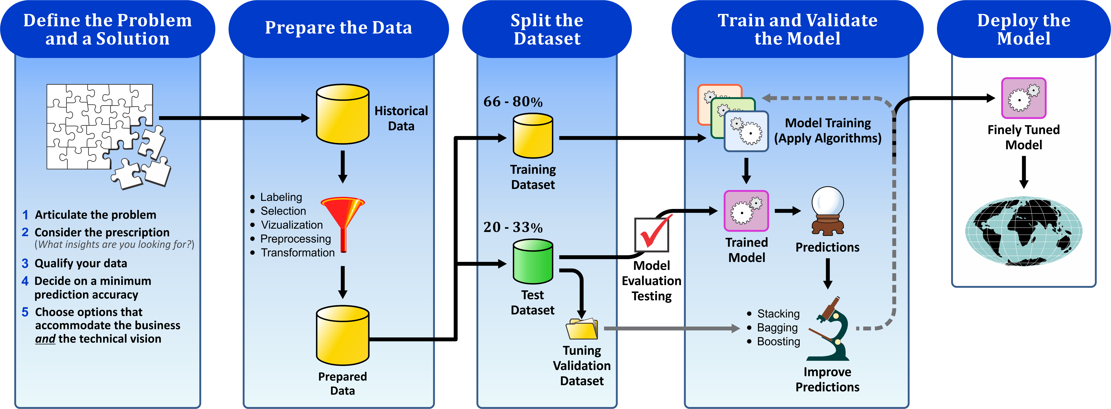
Machine Learning steps

Slide 12
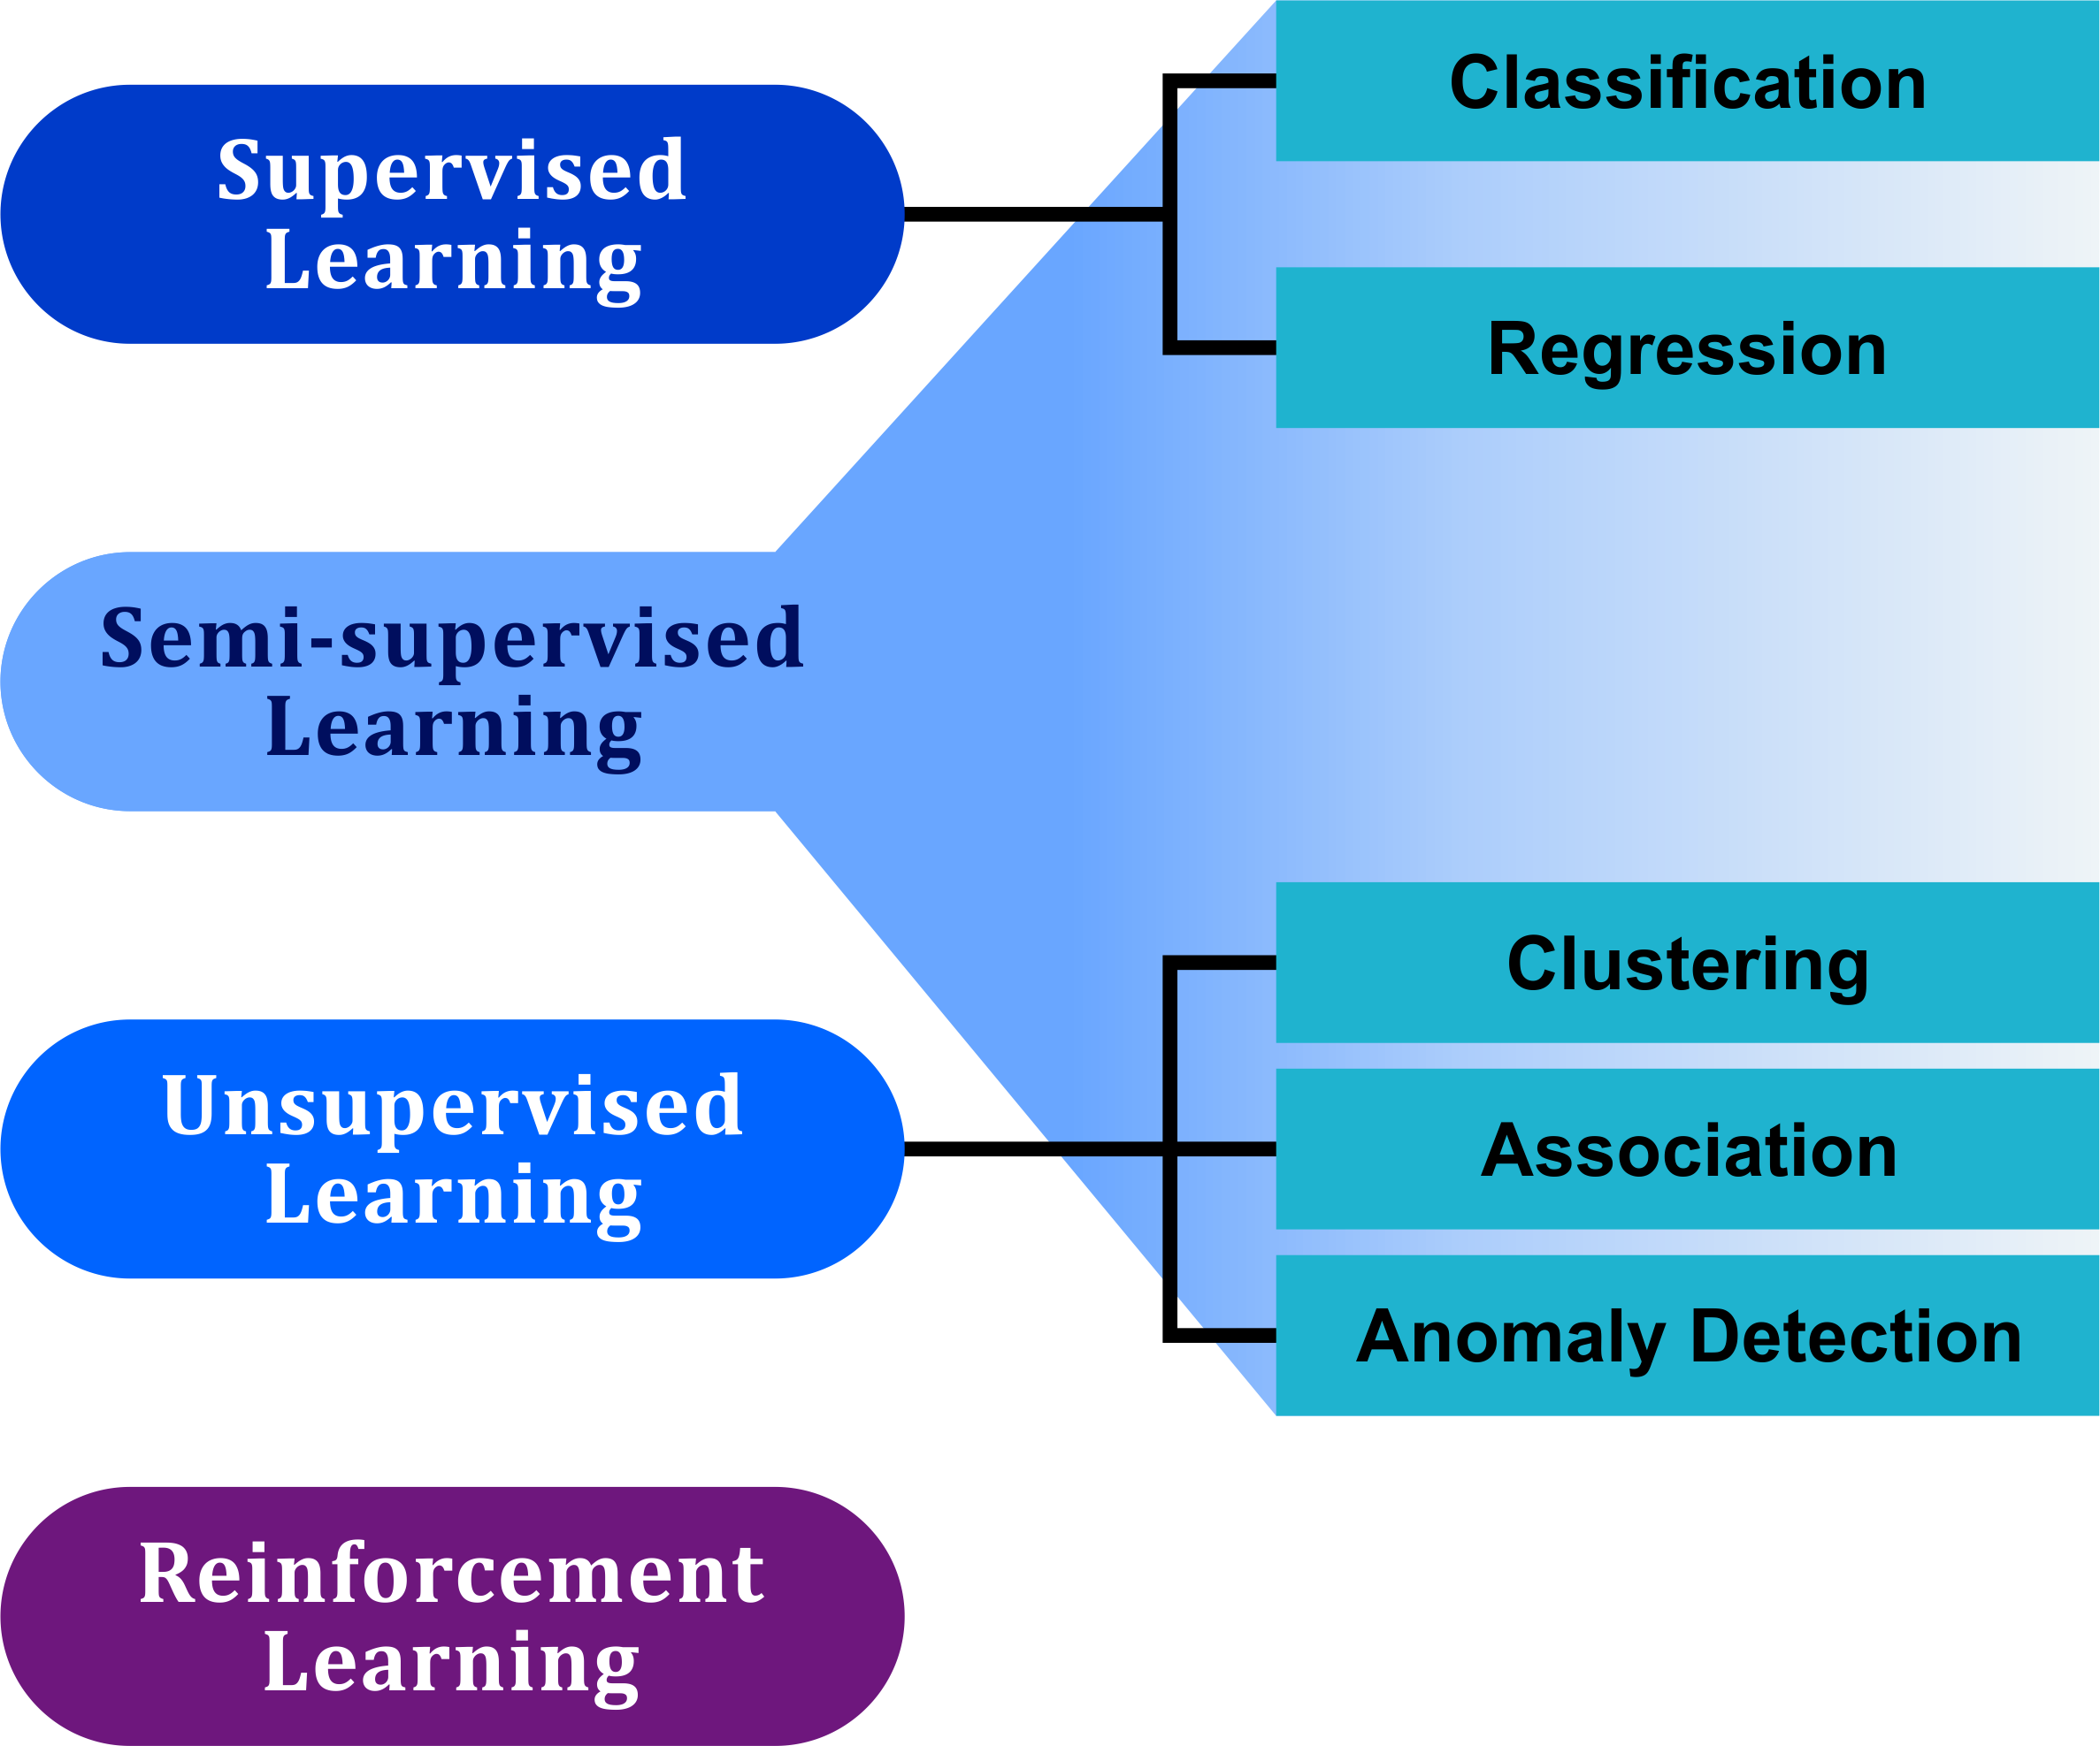
Machine Learning Models
Based on the data available and the question at hand, a machine learning algorithm will be trained using one of four different learning models

Slide 13
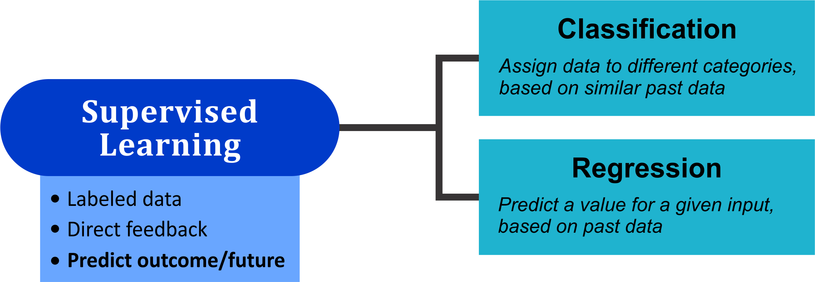
Supervised Learning
Using past data to make predictions

Slide 14
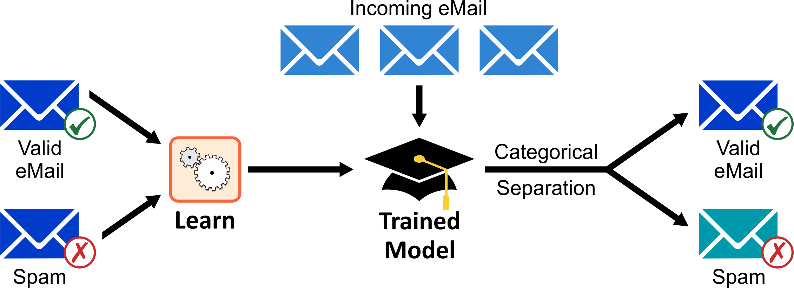
Supervised Learning - Classification
Assign data to different categories, based on similar past data

Slide 15
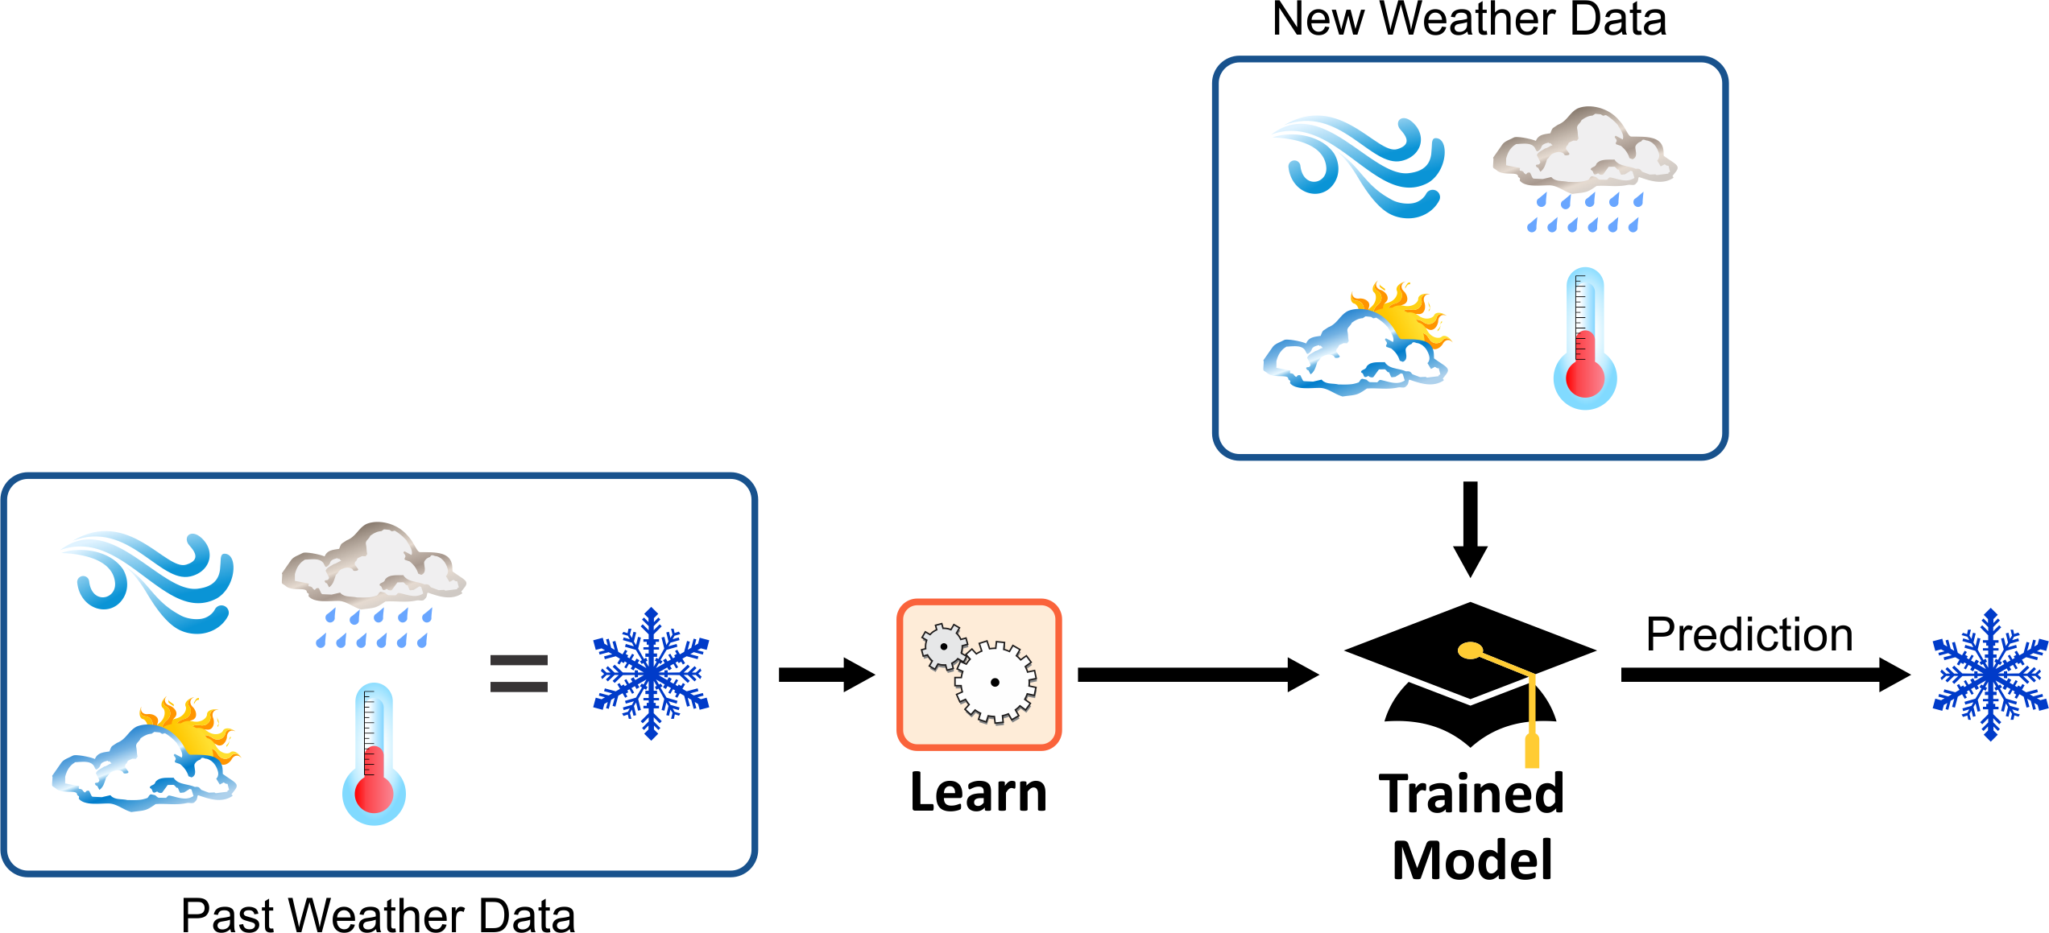
Supervised Learning - Regression
Predict a value for a given input, based on past data

Slide 16
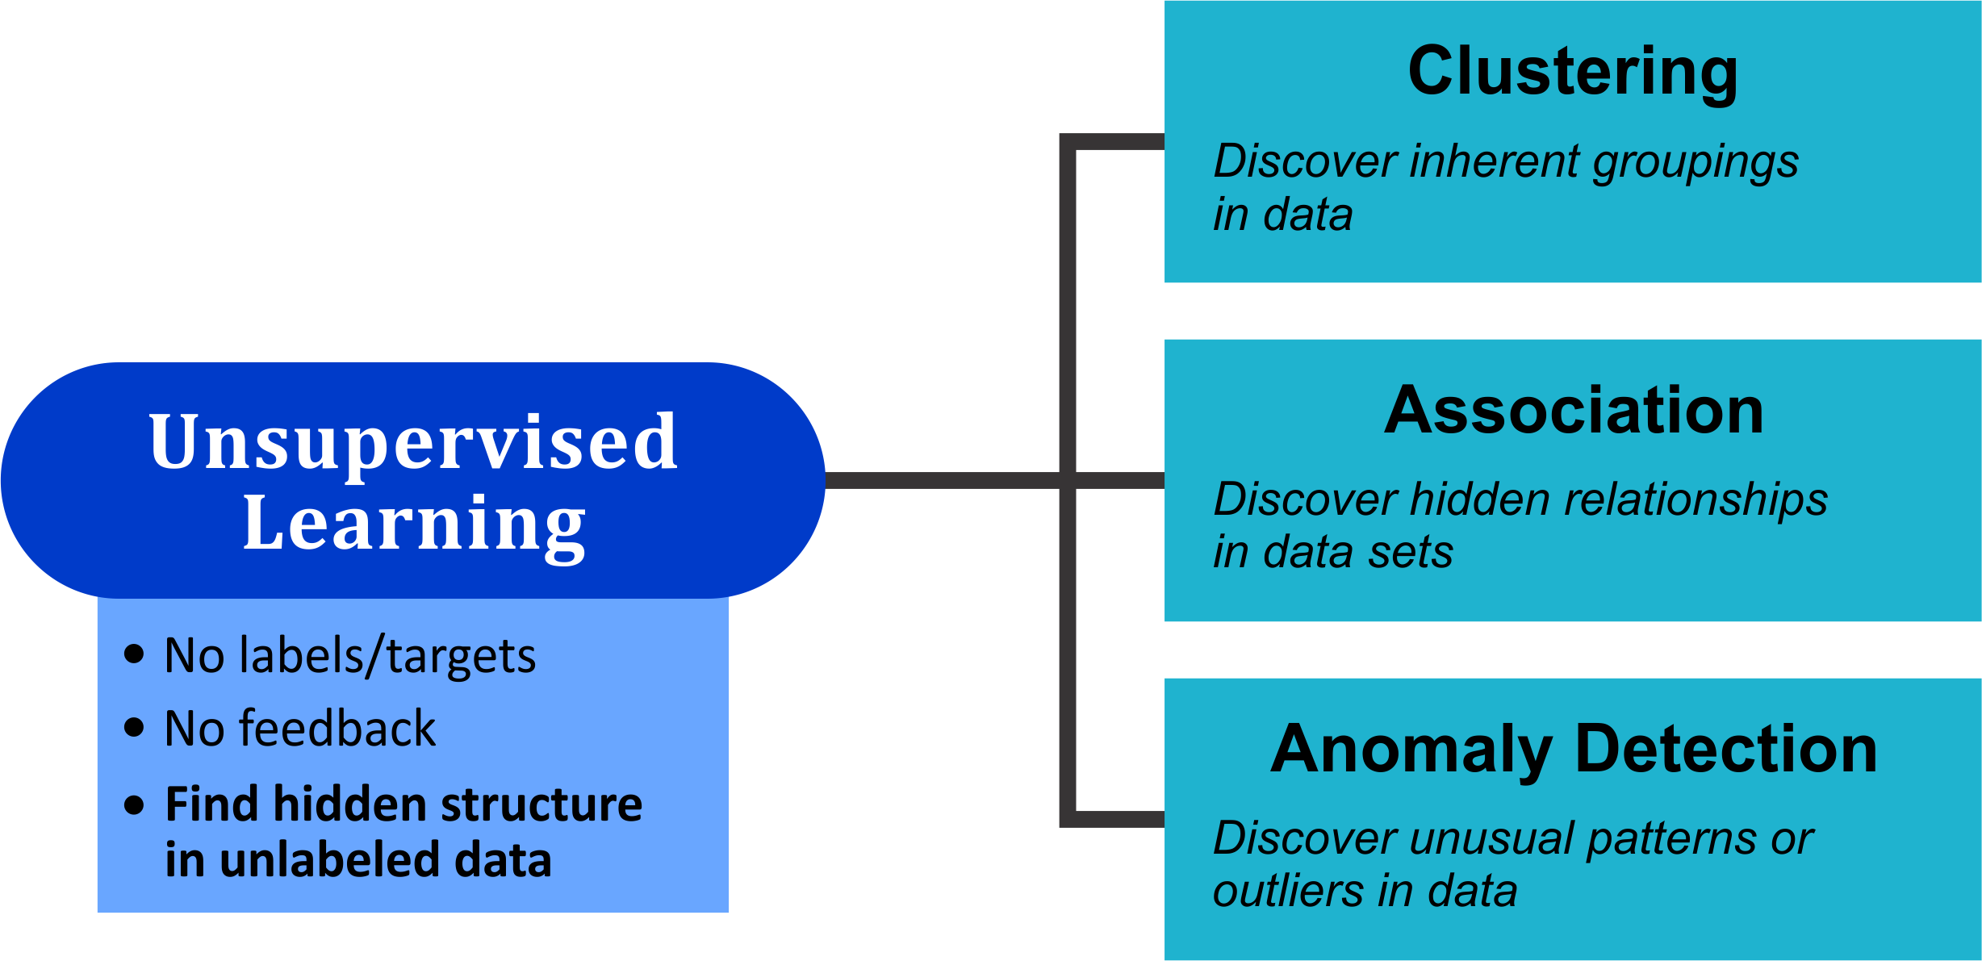
Unsupervised Learning
Finding structure in data by extracting hidden features

Slide 17
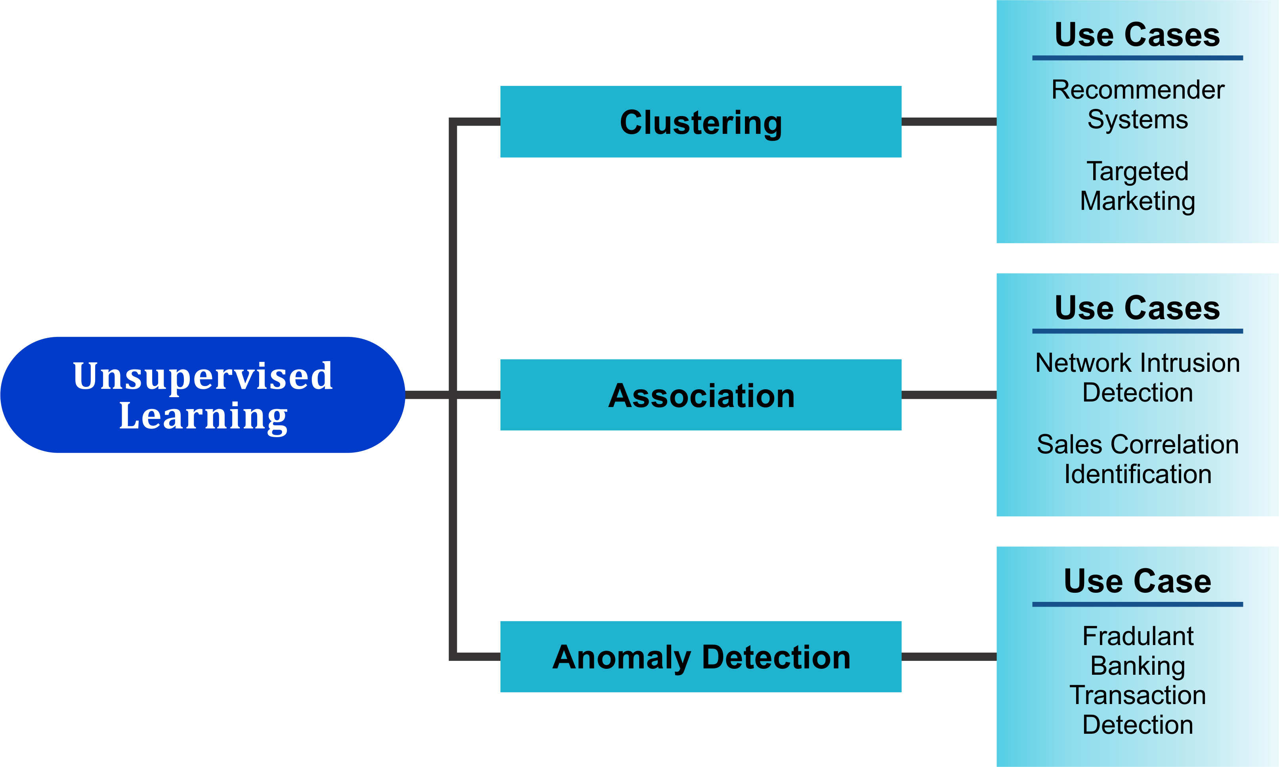
Unsupervised Learning – Use cases

Slide 18
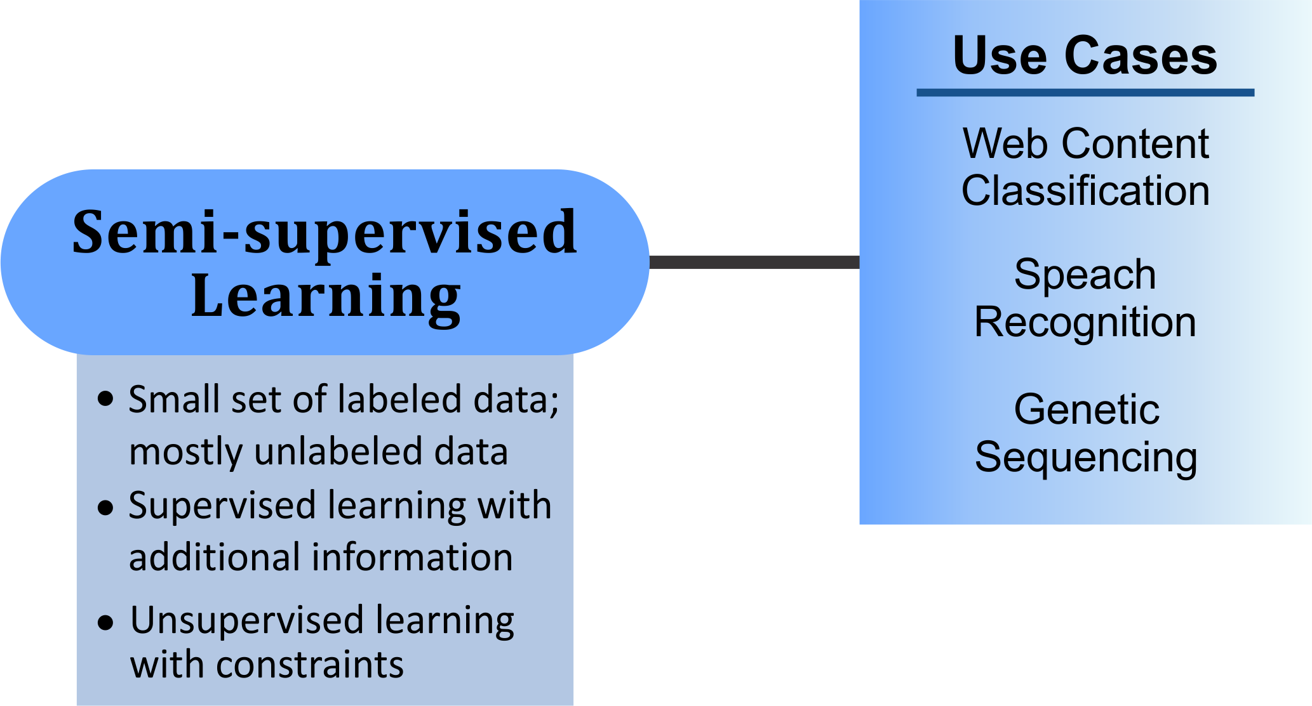
Semi-supervised Learning
When extracting relevant features from data is difficult and labeling all of the data is too time-intensive

Slide 19
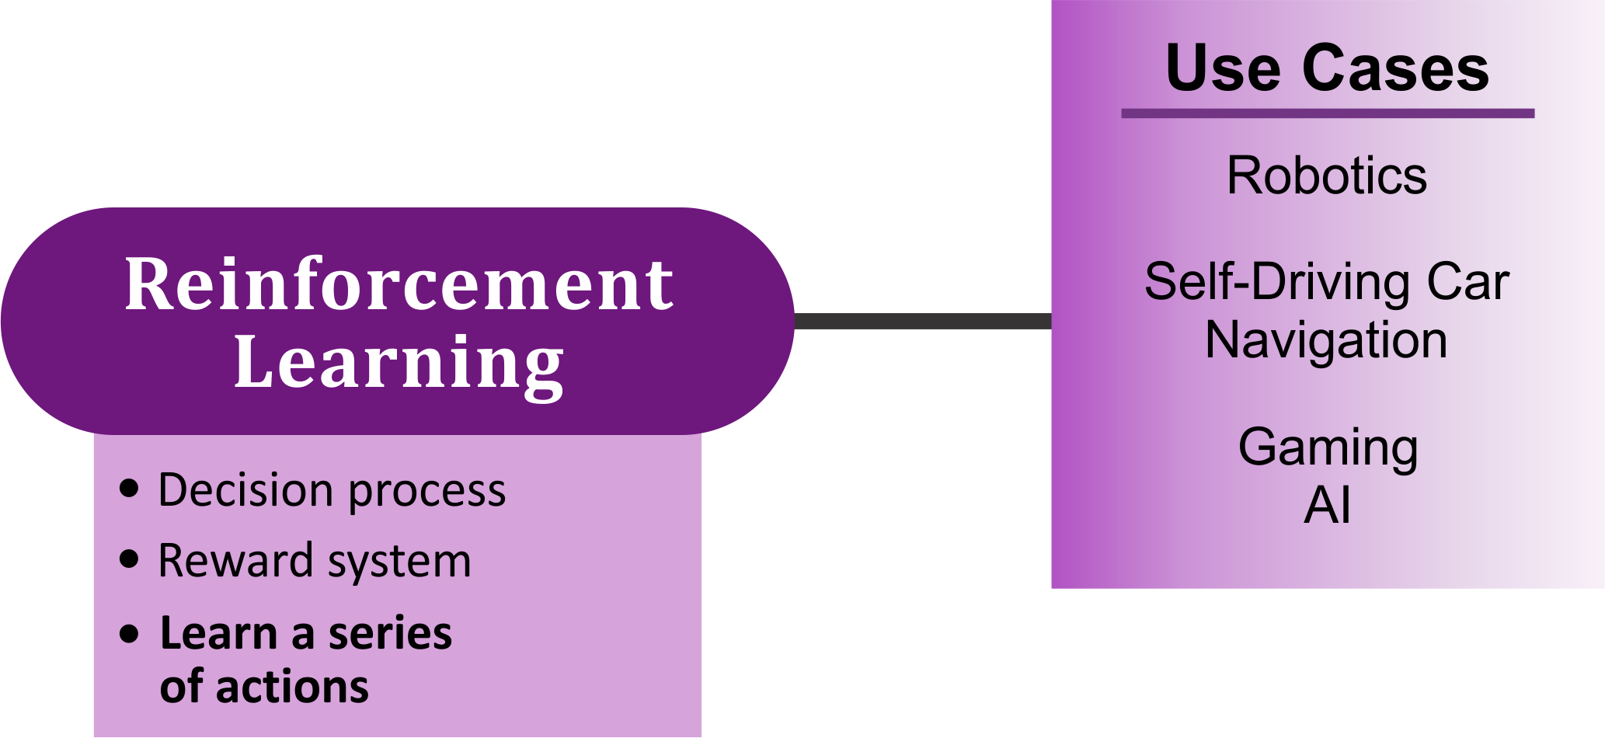
Reinforcement Learning
Predicting the best next step to take to earn the biggest reward

Slide 20
Secure Gateway Service
Quickly set up gateways to connect environments, manage mapping between local and remote destinations, and monitor traffic
Access management controls are available to allow or deny access on a per resource basis
Can be configured to provide TLS encryption and mutual authentication for all communication
Essentials plan offers 1 secure gateway between 1 client and 1 destination and 500MB of data transmission per month at no cost
Create a secure, persistent connection between your protected environment and the cloud

Slide 21
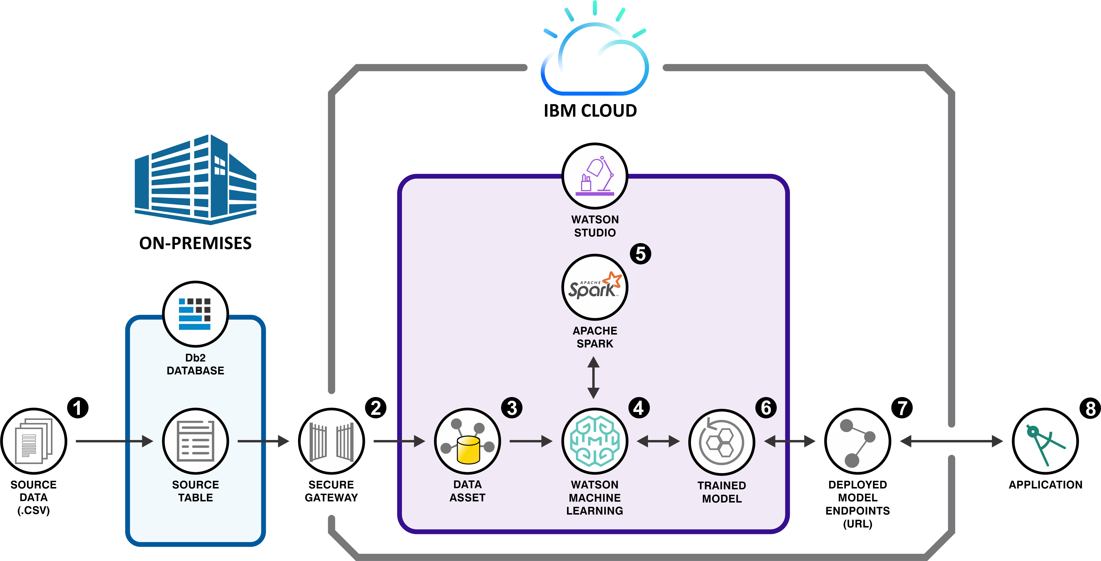
Db2 on-premises database code pattern flow
Notes:
Initial source data is loaded into IBM Db2 database (that is running in a Docker container).
A secure gateway to IBM Cloud is created and configured.
The source data is then loaded, as a data asset in Object Storage, into Watson Studio.
The Watson Machine Learning service uses the source data and Apache Spark-as-a-service (5.) to compute an evaluation.
Once the evaluation is done, the Watson Machine Learning service creates a machine learning model.
The deployed model endpoints are exposed through a URL.
Applications can use the URL to work with the model.

Slide 22








Db2 on-premises database code pattern flow – details
Initial source data is loaded into IBM Db2 database (that is running in a Docker container).
A secure gateway to IBM Cloud is created and configured.
The source data is then loaded, as a data asset in Object Storage, into Watson Studio.
The Watson Machine Learning service uses the source data and Apache Spark-as-a-service (5) to compute an evaluation.
Once the evaluation is done, the Watson Machine Learning service creates a machine learning model.
The deployed model endpoints are exposed through a URL.
Applications can use the URL to work with the trained model.

Slide 23

A word about Db2 on Cloud
Fully managed SQL cloud database ideal for developers who want to develop in a public cloud
One-click deployment
Reduce the time needed to start projects
Rapidly provision compute and storage resources
RESTful APIs simplify database communication (no drivers needed)
Free tier available (100MB database size limit)
Build faster in the cloud, with one-click deployment

Slide 24
®

Slide 25
Color palette
R-0 G-0 B-0
R-110 G-23 B-125
R-0 G-15 B-94
R-255 G-255 B-255
R-110 G-23 B-125
R-0 G-15 B-94
R-234 G-234 B-234
R-31 G-179 B-207
R-0 G-59 B-201
R-234 G-234 B-234
R-31 G-179 B-207
R-0 G-59 B-201
R-219 G-38 B-99
R-105 G-166 B-255
R-0 G-100 B-255
R-219 G-38 B-99
R-105 G-166 B-255
R-0 G-100 B-255

